Slide 1
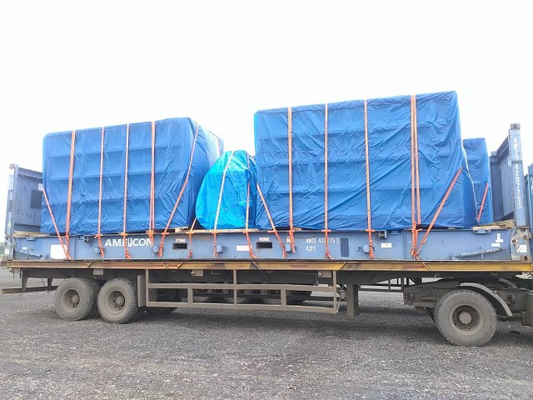
PROJECTS EXECUTED
...Integrating Value Chains
SCOPE OF WORK : MOVEMENT OF ODC CONTAINERS FROM HAMBURG TO DOHA. Total : 36 Special Equipments.
Anything Anywhere Anytime
Hitachi Transport System Group

Slide 2
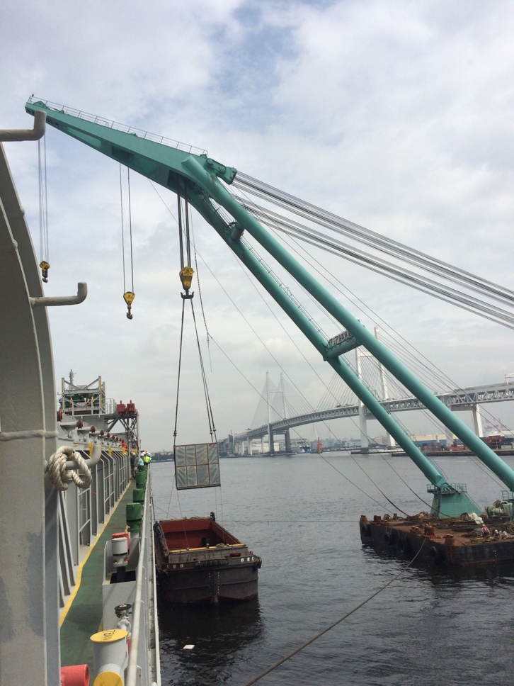
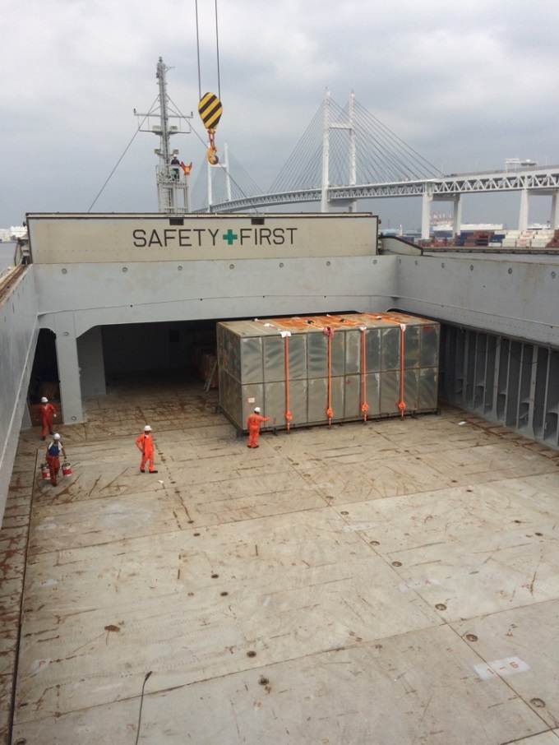
PROJECTS EXECUTED
...Integrating Value Chains
SCOPE OF WORK : Movement of 1 x 110 Ton Package + Accessories from Yokohama to Mumbai.
Anything Anywhere Anytime
Hitachi Transport System Group

Slide 3
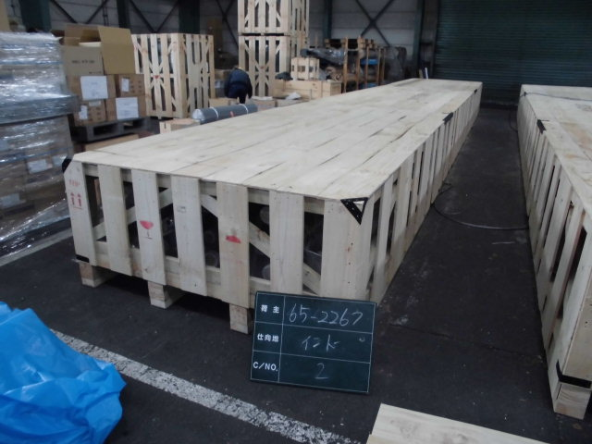
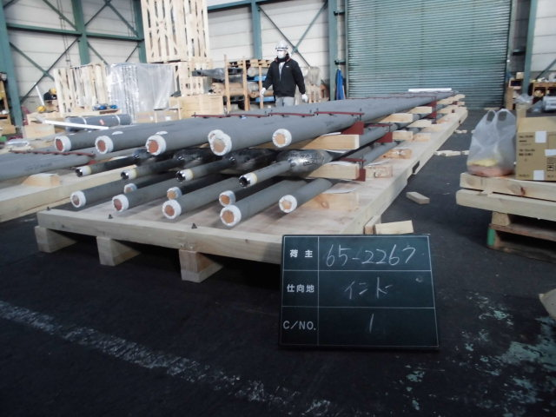
PROJECTS EXECUTED
...Integrating Value Chains
SCOPE OF WORK : Movement of Breakbulk Cargo of 95 FRT from Kobe to Mumbai.
Anything Anywhere Anytime
Hitachi Transport System Group

Slide 4
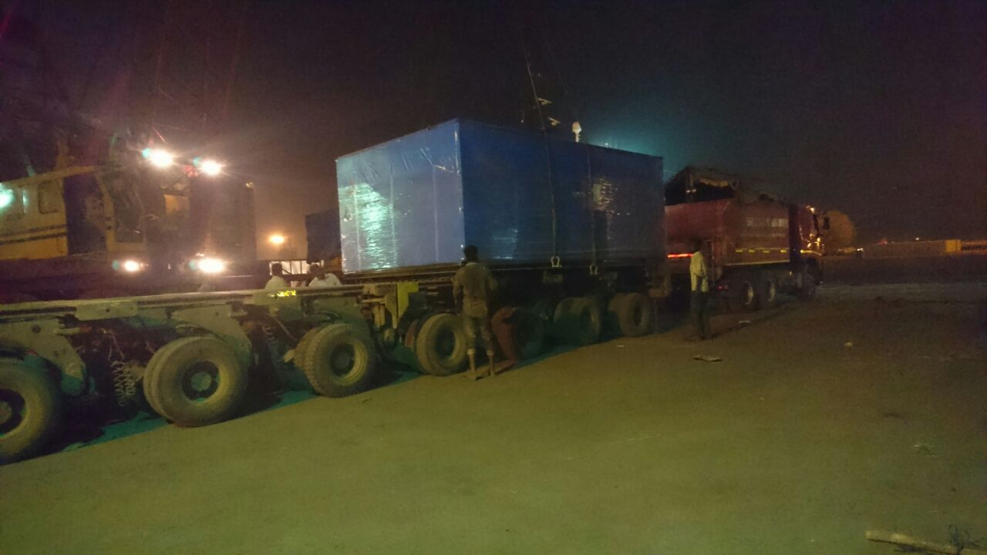
PROJECTS EXECUTED
...Integrating Value Chains
SCOPE OF WORK : Movement of Breakbulk Cargo of 250 FRT from Yokohama to Mumbai. 2 x 40 tons + Accessories.
Anything Anywhere Anytime
Hitachi Transport System Group

Slide 5
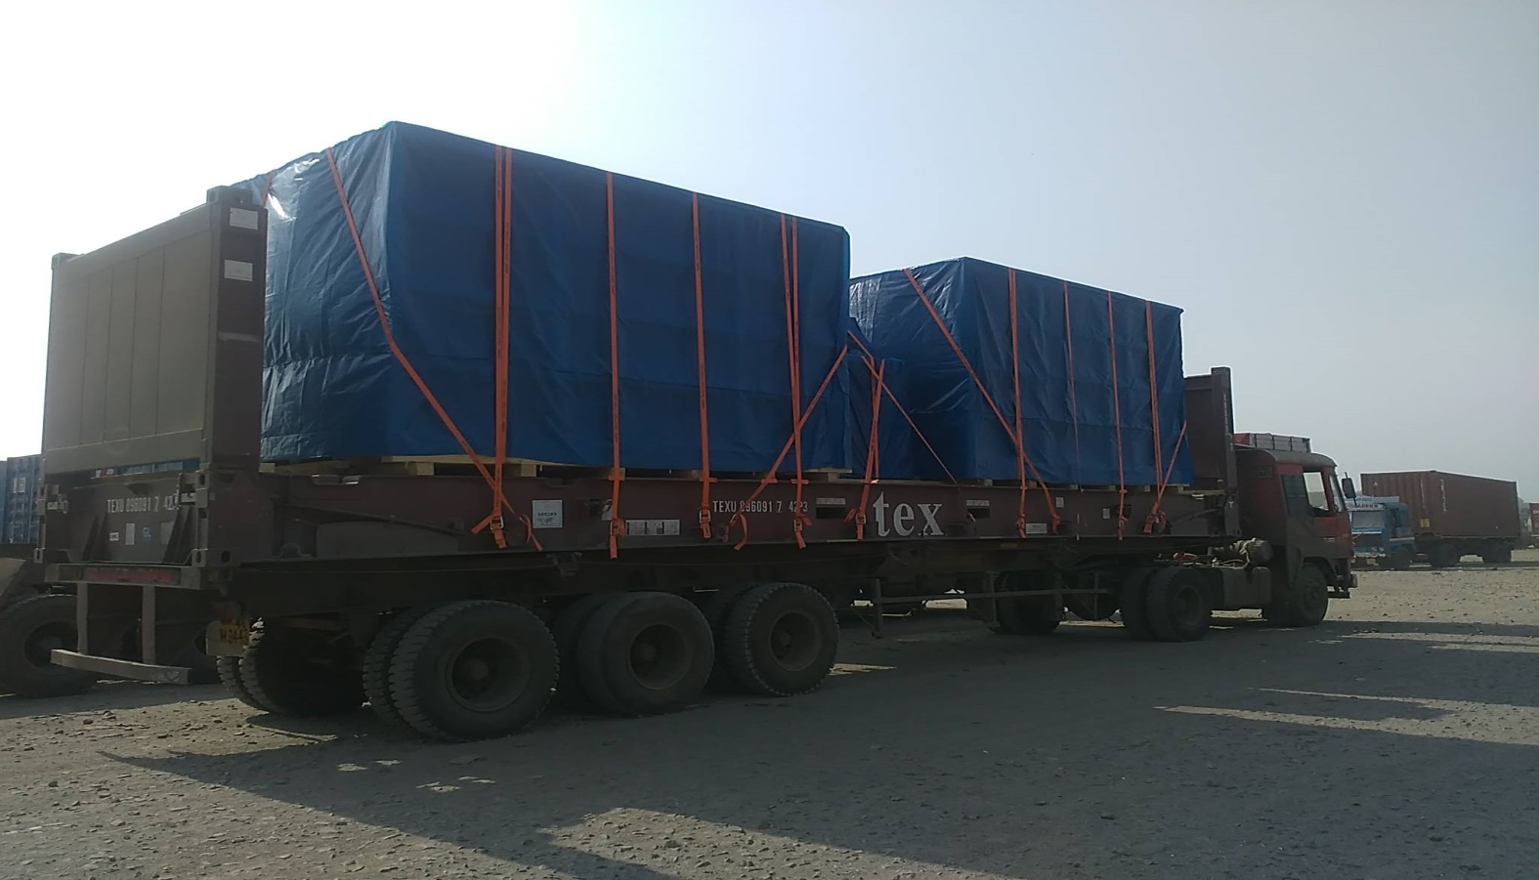
PROJECTS EXECUTED
...Integrating Value Chains
SCOPE OF WORK : MOVEMENT OF 40 X 40’ FLAT RACK CONTAINERS FOR DEWA PROJECT.
Anything Anywhere Anytime
Hitachi Transport System Group

Slide 6
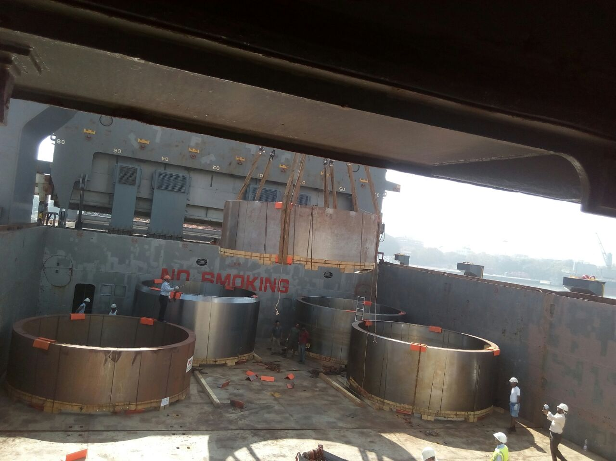
PROJECTS EXECUTED
...Integrating Value Chains
SCOPE OF WORK : MOVEMENT OF SHELLS FROM MARGHERA TO HAZIRA .
516 FRT. HEAVY LIFTS FROM 50 TONS TO 75 TONS EACH.
Anything Anywhere Anytime
Hitachi Transport System Group

Slide 7
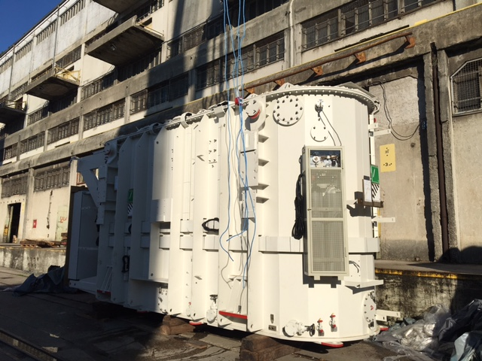
PROJECTS EXECUTED
...Integrating Value Chains
SCOPE OF WORK : MOVEMENT OF TRANSFORMERS FROM RIJEKA, CROATIA TO HAMAD, QATAR. 2 X 90 TONS + ACCESSORIES. TOTAL : 900 FRT
Anything Anywhere Anytime
Hitachi Transport System Group

Slide 8
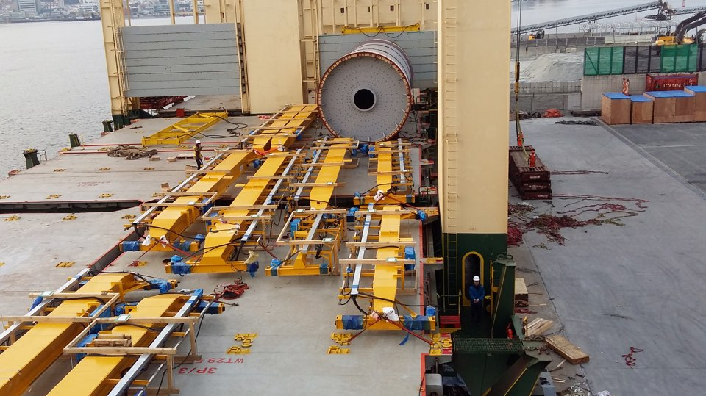
PROJECTS EXECUTED
...Integrating Value Chains
SCOPE OF WORK : MOVEMENT OF EOT CRANE FROM MASAN, KOREA TO SHUAIBA, KUWAIT. TOTAL 850 FRT.
Anything Anywhere Anytime
Hitachi Transport System Group

Slide 9
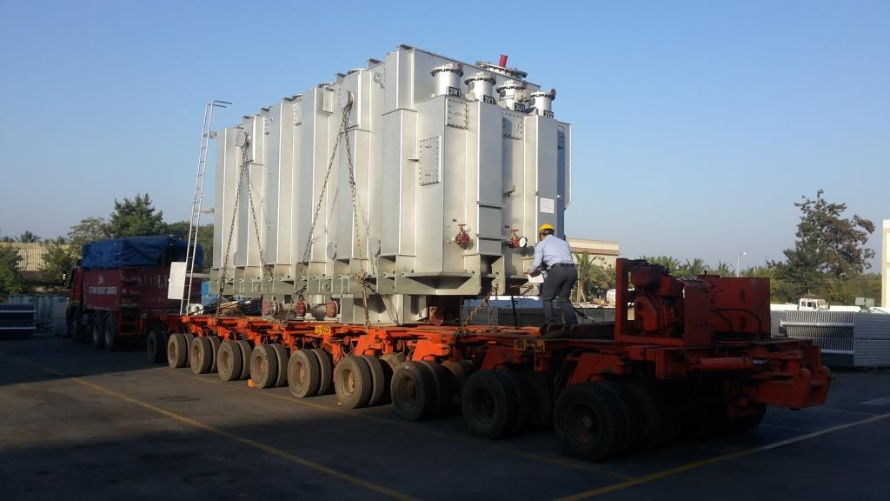
PROJECTS EXECUTED
...Integrating Value Chains
SCOPE OF WORK : MOVEMENT OF 3 X 130 TONS TRANSFORMERS + ACCESSORIES & OIL DRUMS. TRANSPORTATION FROM HYDERABAD TO MUMBAI, CUSTOM CLEARANCE & PORT HANDLING.
Anything Anywhere Anytime
Hitachi Transport System Group

